Slide 1
Subroutines
Procedures / Functions

Slide 2

Subroutine (Procedure/Function)
Subroutine = a named ‘out of line’ block of code that may be executed (called) by simply writing its name in a program statement.
are blocks of code in your program that are called upon from other parts of your program.
provides a way to organise and modularise your code.
can be called with or without parameters.
Adv:
Re-use code: create a common routine once and re-use as many times as you want
Structure your programming/code
Share code with other programs, i.e. easily incorporate other peoples code
Test subroutines/functions independently of the rest of the code
Reduces need for global variables as local variables used instead
Note:
Modularisation is a technique to split your code into separate parts; these parts are called modules.

Slide 3
Subroutine
Program execution starts at the first statement in the main program
Program flow will “jump” to the subroutine when called
When the subroutine has finished, the program will continue from where it was called
Procedures and functions are types of subroutine
Procedure: a sequence of commands or programming code, which does not have to return a value.
Function: a subroutine that returns one or more values
Note: In some programming languages all subroutines are referred to as functions even if no value is returned. In VB.NET subroutines do not use the return keyword to return a value and functions use the return keyword.

Slide 4
Calling a Proc Without Parameters
The statement below calls a Sub named "AddEm" (you "call" or "invoke" a Sub by specifying its name followed by parentheses):
AddEm( )
The Sub "AddEm" would be a section of code in this format:
Sub AddEm( )
[statements]
End Sub
‘ Empty parentheses = without parameters
NOTE:
When the statement "AddEm()" is executed, VB would:
execute the statements in the Sub named "AddEm"
then return to the statement that followed "AddEm()"

Slide 5
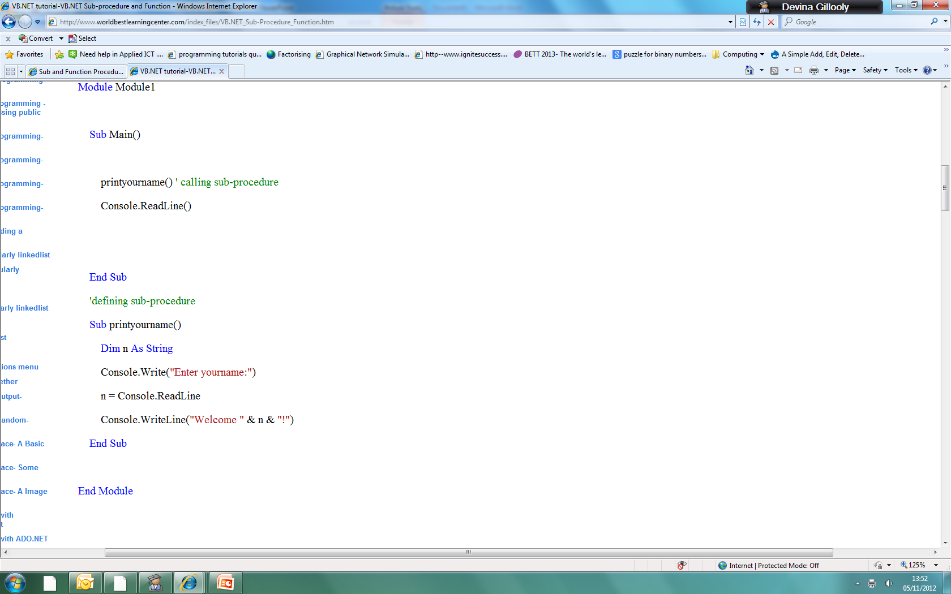
Example 1: Calling a Proc Without Parameters
Code:
Note:
The name of sub-procedure must start with a letter or underscore not a number

Slide 6
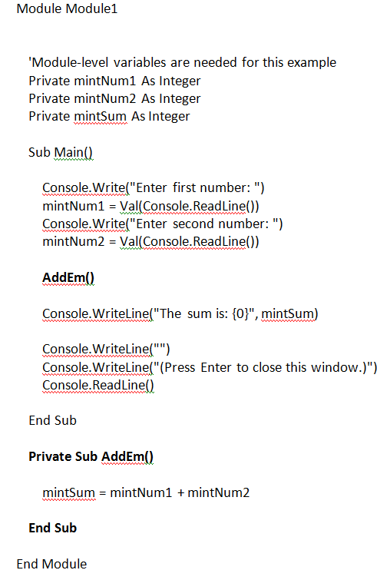
Example 2: Calling a Proc Without Parameters
Code:
Note:
When this sample program is run, the user is prompted to enter two numbers.
The AddEm Sub is called, which performs the addition. Program flow then returns to the Console.WriteLine statement, which displays the sum of the two numbers.
Note:
Variables involved are declared at the module-level (i.e., general declarations section, or the section of the module prior to any Subs or Functions) because the variables are common to both the main method and the AddEm Sub procedure.
Note: Ignore the Private keywords in code for now

Slide 7
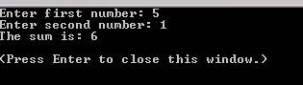
Example 2: Outcome

Slide 8
Complete Task:
Writing a Subroutine with no parameters

Slide 9
Passing parameters
Parameters in parentheses are used to pass data to a subroutine
What values are passed to the subroutine in the example below?
What identifiers are used to hold the values?
SUB multiply(x,y)
print “The product is: ”, x * y
ENDSUB
#call subroutine
multiply(2,5)

Slide 10
Passing parameters
The order of the parameters in parentheses is important
What is the output here?
SUB calc (x, y, z)
ans = (x * y) + z
print ans
ENDSUB
#call subroutine
calc(2,5,6)
calc(2,6,5)

Slide 11
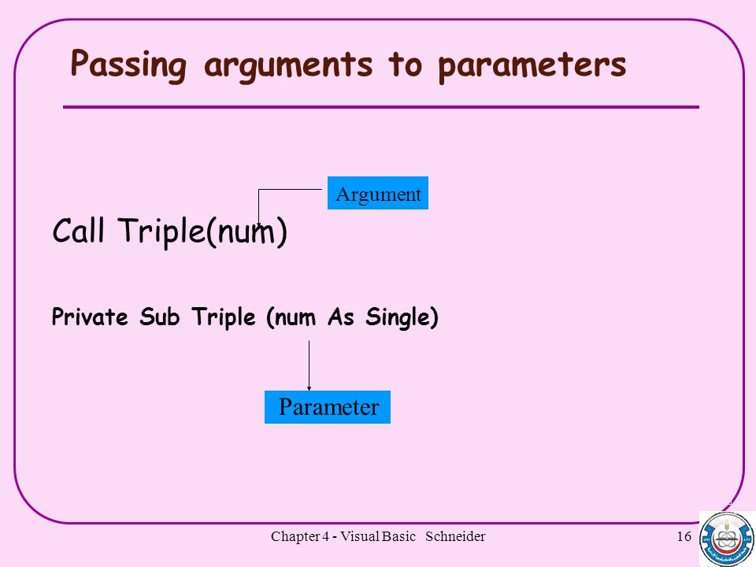
Parameters and arguments
The terms parameter and argument are often used interchangeably
Strictly speaking, parameters appear in subroutine definitions, and arguments appear in subroutine calls
Look back at the code on the previous slide
Can you identify the parameters and arguments?
The arguments may vary from call to call, but the parameters are part of the subroutine definition

Slide 12
Calling a Procedure with Parameters
More often than not, a procedure will be expecting one or more parameters. This enhances the reusability and flexibility of the Sub procedure.
The syntax for a Sub procedure is:
[Private | Public] Sub SubName[(parameter list)]
[statements]
End Sub
For example, if we were to modify the "AddEm" Sub to accept three Integer variables,
the header for the "AddEm" Sub would look like this:
Private Sub AddEm(pintNum1 As Integer, pintNum2 As Integer, pintSum As Integer)
The call to AddEm must now specify, or pass, three integer variables to the Sub
AddEm(intNum1, intNum2, intSum)
**With the naming conventions used in these examples, the variable names of the parameters in a Sub or Function header
start with the letter "p" for "parameter"
"parameter list" is a comma-separated list of the parameter variables with their data types (i.e., var1 As datatype, var2 As datatype, etc.)
Parameter list
Important:
Argument list of the calling statement must match the parameter list of the subroutine one-for-one in terms of both the number of variables passed and the data types of the variables passed.
The names of the corresponding argument/parameter variables can be (and often are) different.
Argument list:
Argument list contains variables names and should be in order.

Slide 13
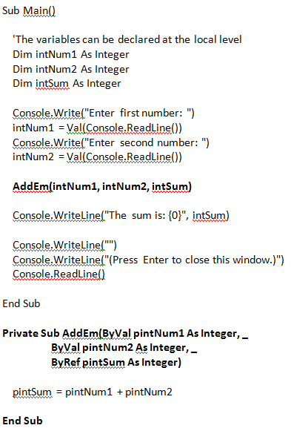
Example (Calling a Sub with Parameters)
Code:
Notes:
In this sample program, the user is prompted to enter two numbers. The Addem Sub is called, which performs the addition. Program flow then returns to the Console.WriteLine statement, which displays the sum of the two numbers.
Difference: the three variables (the two addends and the sum) are passed as arguments to the Sub AddEm. When the call is made, the Sub AddEm adds pintNum1 and pintNum2, storing the result in pintSum. When program flow returns to the Console.WriteLine statement, the value of pintSum that was calculated in AddEm is available in its counterpart intSum. (It is important that the keyword ByRef precede pintSum in the header for the Sub AddEm procedure. The meaning of ByRef and ByVal is explained later.)
The variables involved are declared at the local level (i.e., in the main method, rather than in the general declarations section). A general rule-of-thumb is that variables should be as limited in scope as possible.
When this example is run, it will behave exactly the same as the previous example (i.e. without parameters).

Slide 14

ByRef vs. ByVal (Additional Notes)
Variables can be passed to a subroutine "by reference" or "by value", which are specified with the ByRef or ByVal keyword, respectively.
The default in VB.NET is "by value". (This is a change from previous versions of VB, where the default was "by reference".)
The differences are as follows:
by reference: only the memory addresses of the variables are passed;
meaning that the values passed can be modified by the subroutine and would have the new value after the subroutine exits and returns control to the calling program.
Important: A variable that is expected to contain a "return" value or output value must be passed by reference.
by value: a copy of the variable is passed;
meaning that even if the values passed are modified by the subroutine, those modified values remain local to that subroutine. When the subroutine exits and returns control to the calling program, the variables that were passed by value retain the value they originally had before the call.
Appropriate variables to pass by value would be "input" values to the subroutine. "Input" values to the subroutine can be passed either by reference or by value; it would be "proper" to pass them by value. As long as the subroutine does not modify the input variables, there is no "harm" in passing them by reference. Be advised that you take a bit of a performance hit when you pass subroutine arguments by value – passing by reference is faster.

Slide 15
Complete Task:
Writing a Subroutine with parameters

Slide 16
Class Task
Complete the following 2 programs in class today:
Exercise question within the ‘Sub with no parameters’.
Task example for the ‘Subroutine with parameters’.
Submit your work to Firefly using the Solution Template!
Don’t forget to include your independent work within the solution template before submitting.

Slide 17
Independent Work (mandatory)
Describe briefly three advantages of using subroutines in programs. [6]
2. A primary school teacher requires a program that will allow pupils to practise their multiplication tables (times tables). The program must allow them to choose the table they want displayed and the start and end numbers to multiply by.
For example, if the pupil enters 5, 4, 12 the program will display
5 x 4 = 20
5 x 5 = 25
…
…
5 x 12 = 60
The program will then print a message followed by the table selected.
Create a solution for this using a subroutine called multiples() which takes table, startnum, endnum and pupilName as parameters. The subroutine will output the message and multiplication table. The main program will prompt the user to enter the values and will then pass them to the routine.

